Slide 1
Adventure Sales Analysis

Slide 2
agenda
Introduction
Group Details
KPI List
Excel Dashboard
Tablue Dashboard
Power BI Dashboard
SQL Script
Summery of Project
Suggestions
Final Tips &Take Away

Slide 3
introduction
Adventure Works Cycles is a large multinational company that manufactures and sells bicycles
Sells to markets across North America, Europe and Asia
Head office is in Bothell, Washington with 290 employees
Has regional sales teams spread across all major markets
In 2000s, expanded by acquiring a manufacturing plant in Mexico for key bicycle parts
In 2001, the Mexico plant became the sole manufacturer of the Touring Bicycle product group
Company goal — grow market share, reach more customers, and reduce production costs

Slide 4
KPI List
Total Sales
Total Profit
Total Orders
Total Products
Total customers
Quarter wise Sales
Year wise Total product cost & sales
Month wise Total product cost & sales
Month wise Total Sales
Region wise Sales

Slide 5
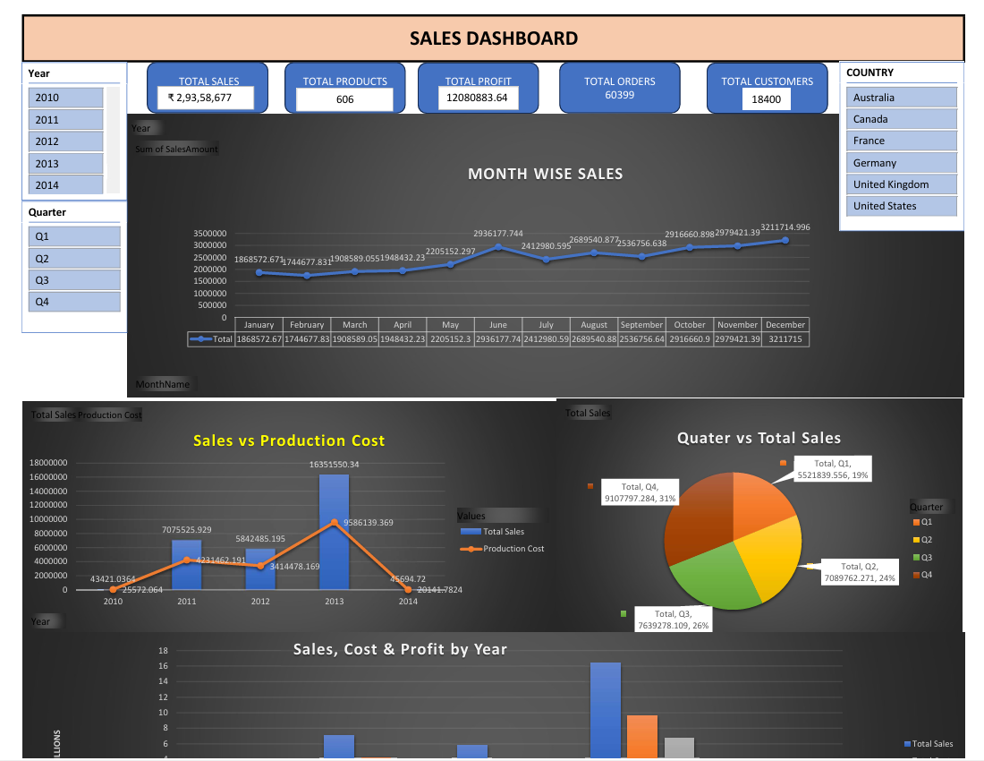
Excel Dashboard

Slide 6
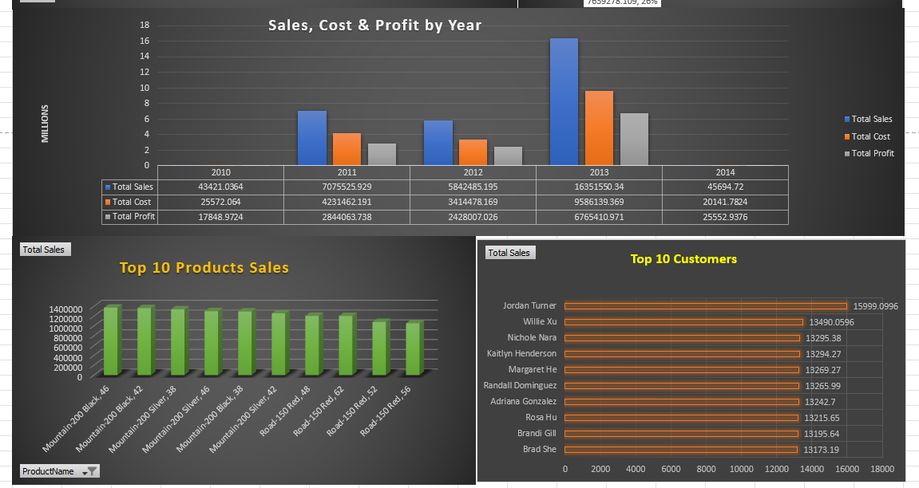
Excel Dashboard

Slide 7
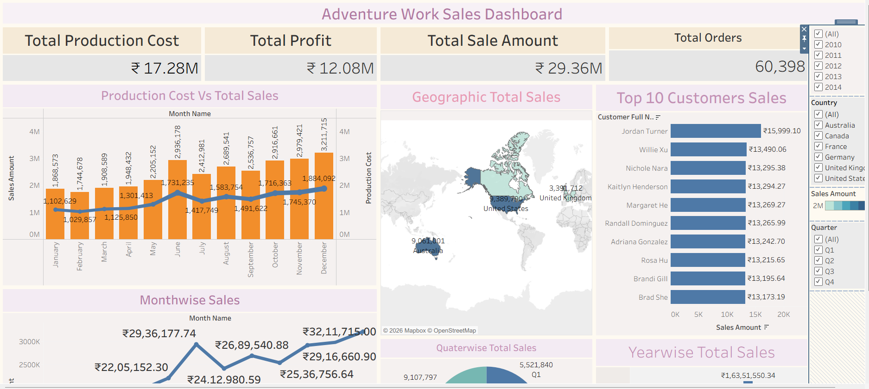
Tablue Dashboard

Slide 8
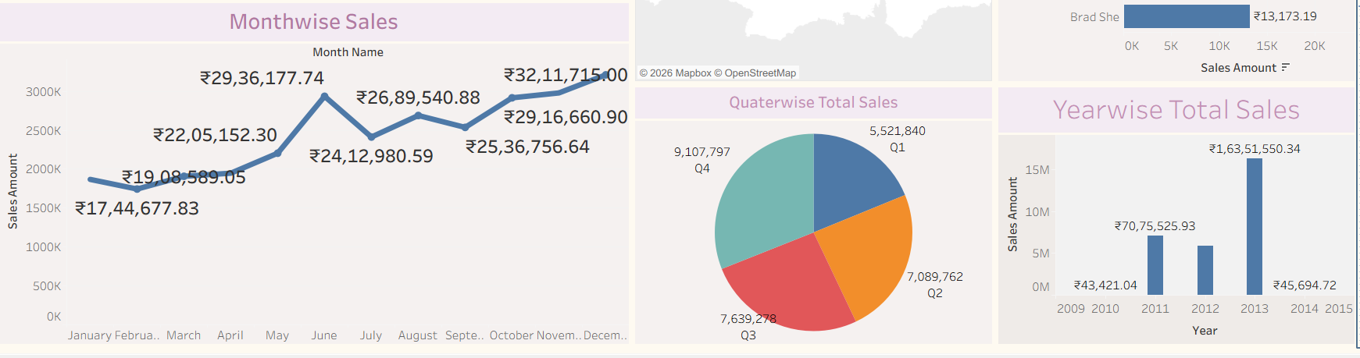
Tablue Dashboard

Slide 9
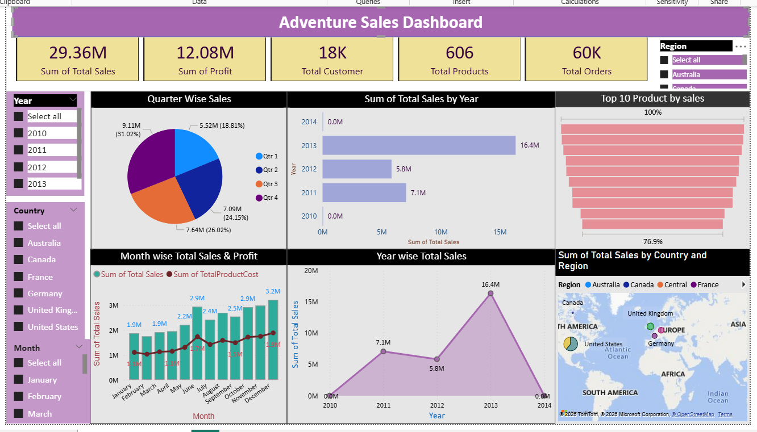
Power BI Dashboard

Slide 10
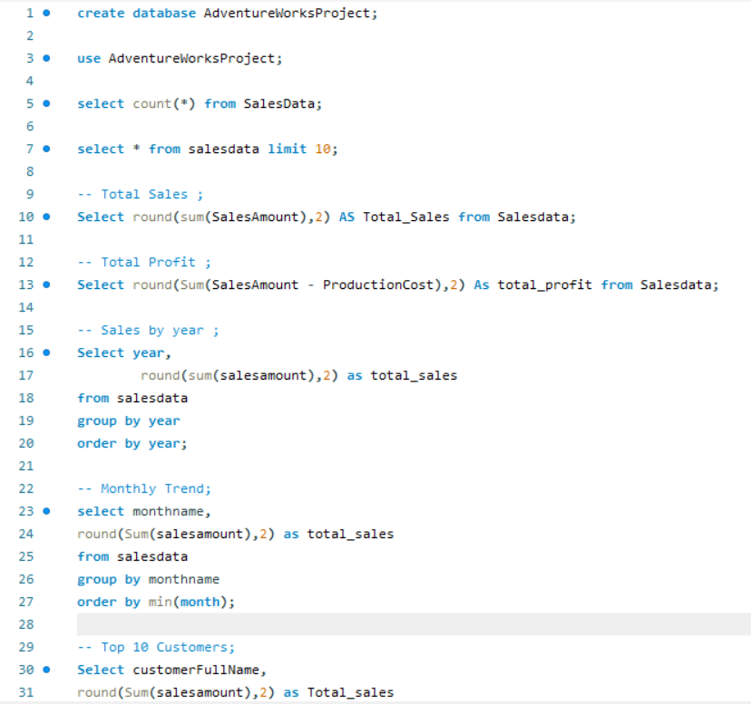
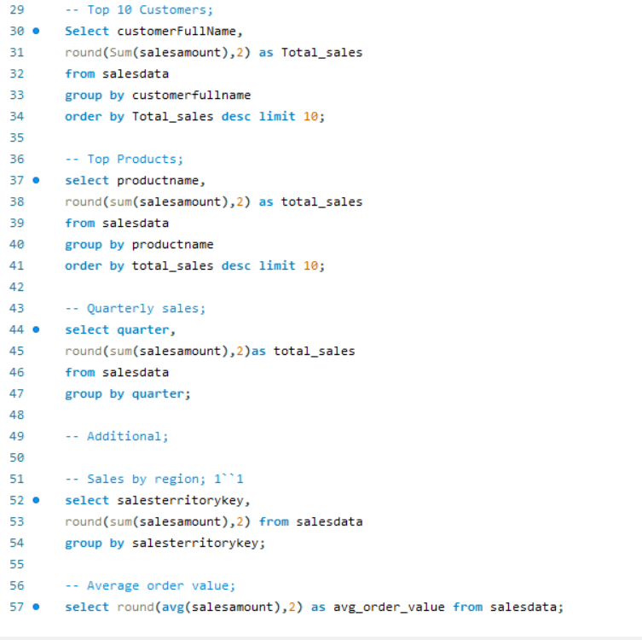
SQL Script

Slide 11
Summery of the Project
The analysis reveals total sales of ₹29.36M, generating a profit of ₹12.08M, across 606 products, 60,398 orders, and 18,484 customers.
Quarter‑wise sales distribution reflects steady growth: highlighting performance across countries.
The line chart further illustrates yearly sales trends, highlighting growth patterns and performance across different years.
The combo chart highlights monthly profit and sales performance across countries.
The bar chart shows year‑wise total production cost and sales.

Slide 12
Suggestions
Total Sales — 29.36 Million
Focus on Q4 marketing campaigns since it generates the highest sales — invest more in festive season promotions
Sales in 2010 and 2014 are very low — investigate the reason and avoid repeating those gaps
Total Customers — 18,000
A large customer base exists — introduce a loyalty or repeat purchase program to retain them
Focus on converting one-time buyers into regular customers
Total Products — 606
Out of 606 products, only a few top products drive most revenue — discontinue or reduce focus on very low selling products
Invest in promoting the top 10 products more aggressively across all markets
Total Orders — 60,000
High order volume shows strong demand — ensure supply chain and stock levels are always maintained
United States is the top market — expand distribution in underperforming countries like France and Germany

Slide 13
Final tips & takeaways
2013 was the best year with 16.4 Million in sales — strategies from that year should be studied and repeated
Q4 is always the strongest quarter — business should plan stock, staff and marketing around this period
Top few products generate most revenue — these need priority attention at all times
United States is the #1 market — followed by Australia and United Kingdom
The business is profitable every single month — production costs are always below sales revenue

Slide 14
Thank you

